Slide 1


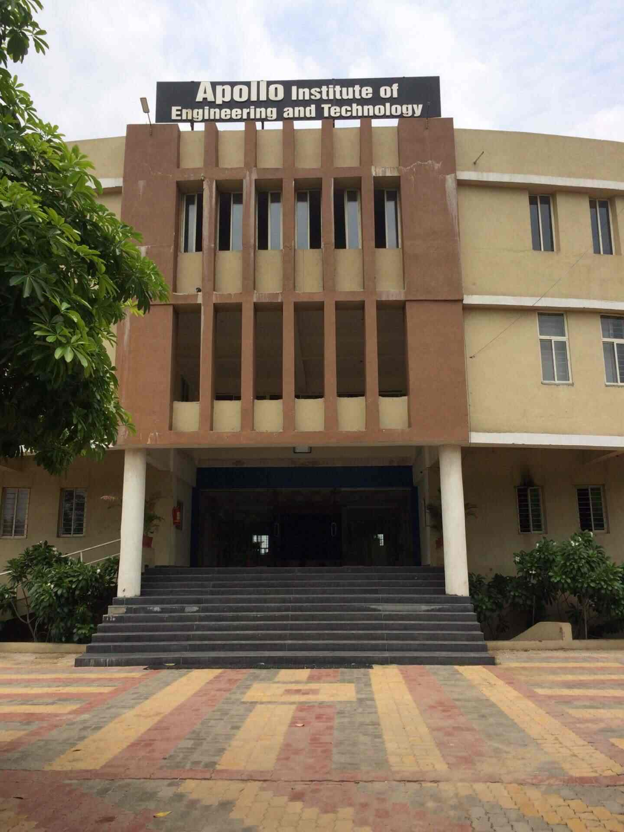
GUJARAT TECHNICAL UNIVERCITY
APOLLO INSTITUTE OF ENGINEERING AND TECHNOLOGY

Slide 2
Name:- Shah Princy R.
Enrollment Number:- 181210116054
Branch:- Information Technology
Semester:- 7
Topic:- Summer Internship
Academic Year:- 2021-2022

Slide 3
“Internship in Akash Technolab In PHP”
Language : PHP
Duration : 26/5/2021 to 10/6/2021
Address : 202 Aarya Arcade Above Passport Seva Kendra, Mithakhali Six Rd, near Shree Krishana Center, Navrangpura, Ahmedabad, Gujarat 380009
Internal Guide : Akash Padhiyar
Contact Number : 9978621654

Slide 4
Day-1
Introduction about Company…How they working and how they provide internship.
Also introduction about PHP ….like What is PHP , Full-form of PHP, which side PHP is work?, What is requirements to driven successfully PHP in your machine and also introduction about XAMPP and WAMPP server.
They have also tell to create a account in Github.com and we upload every single day work in our account.

Slide 5
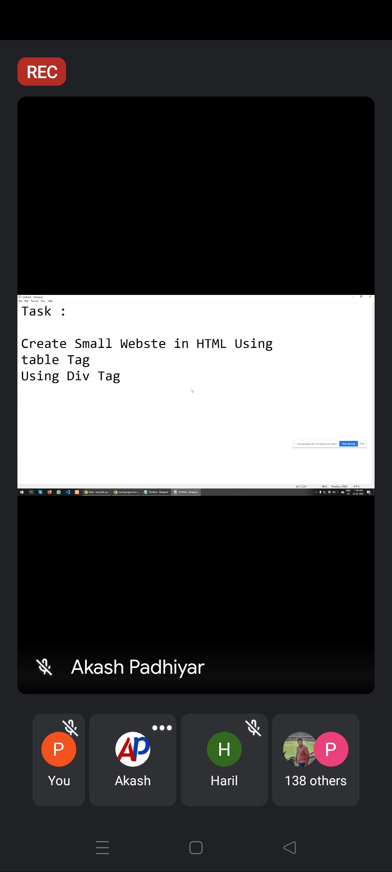
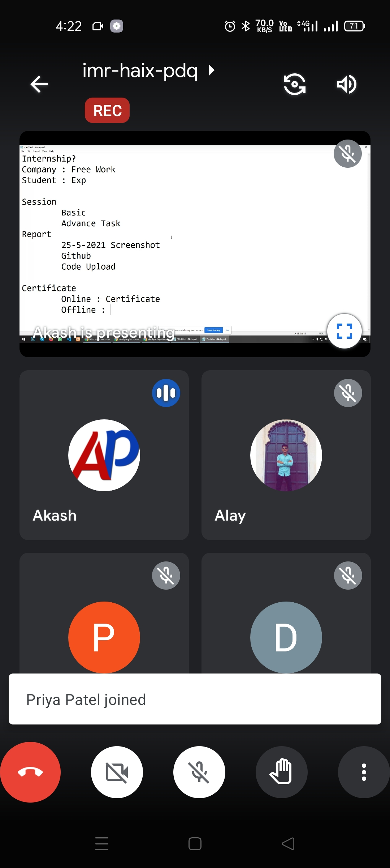
Screenshot of Day-1

Slide 6
Day-2
How to print “Hello World” In PHP.
Introduction about different types of IDE which support PHP ..like VScode, Netbeans, sublimeText, Notepad++.
Loop in PHP Ex: switch, if….else, if, while, do-while….

Slide 7
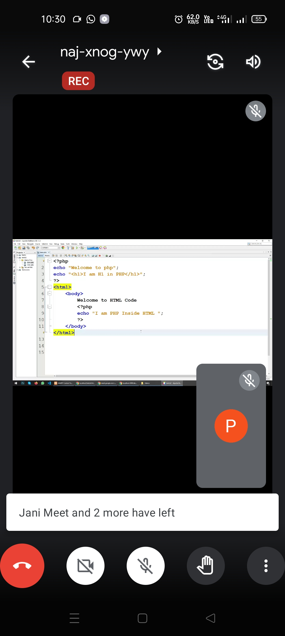
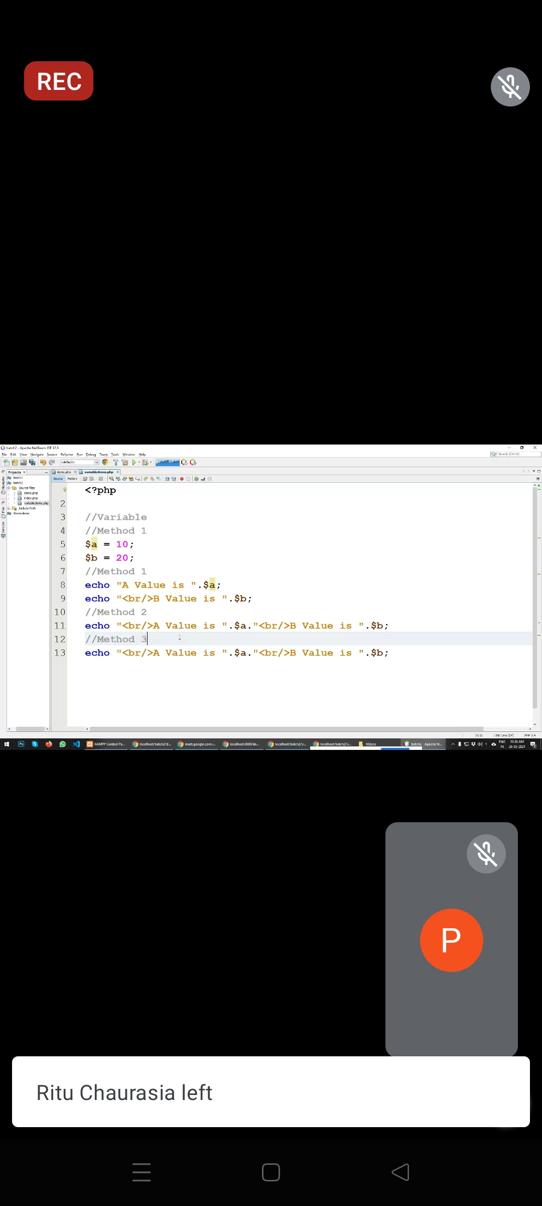
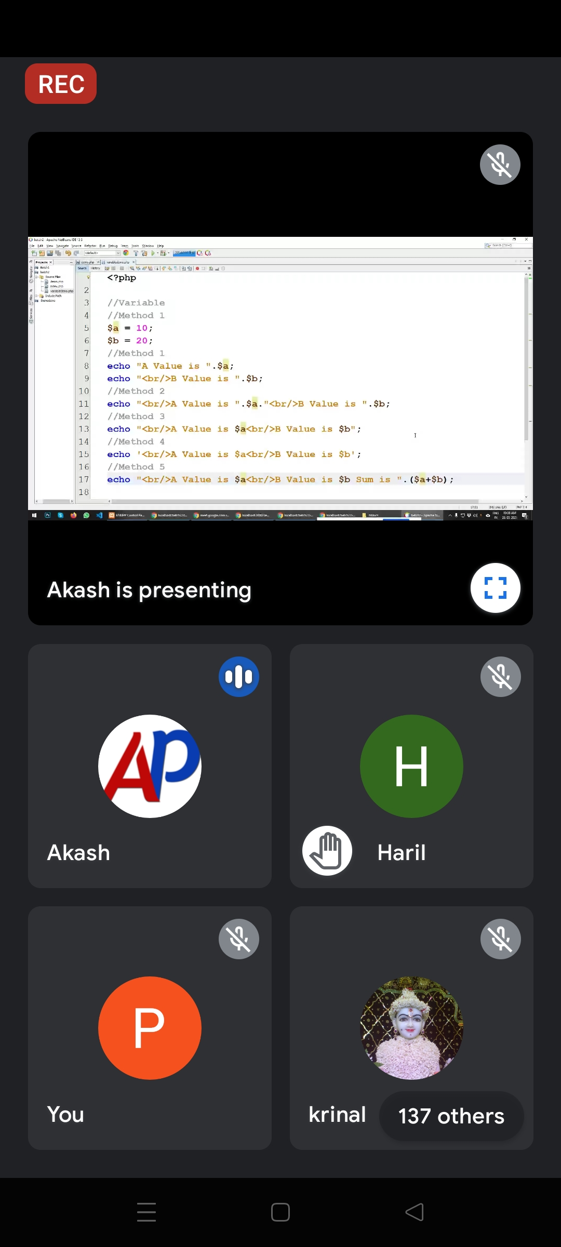
Screenshot of Day-2

Slide 8
Day-3
Some example of PHP
Create table using for loop.
Design student result using PHP.
How to get User defined value and How to print using PHP.

Slide 9
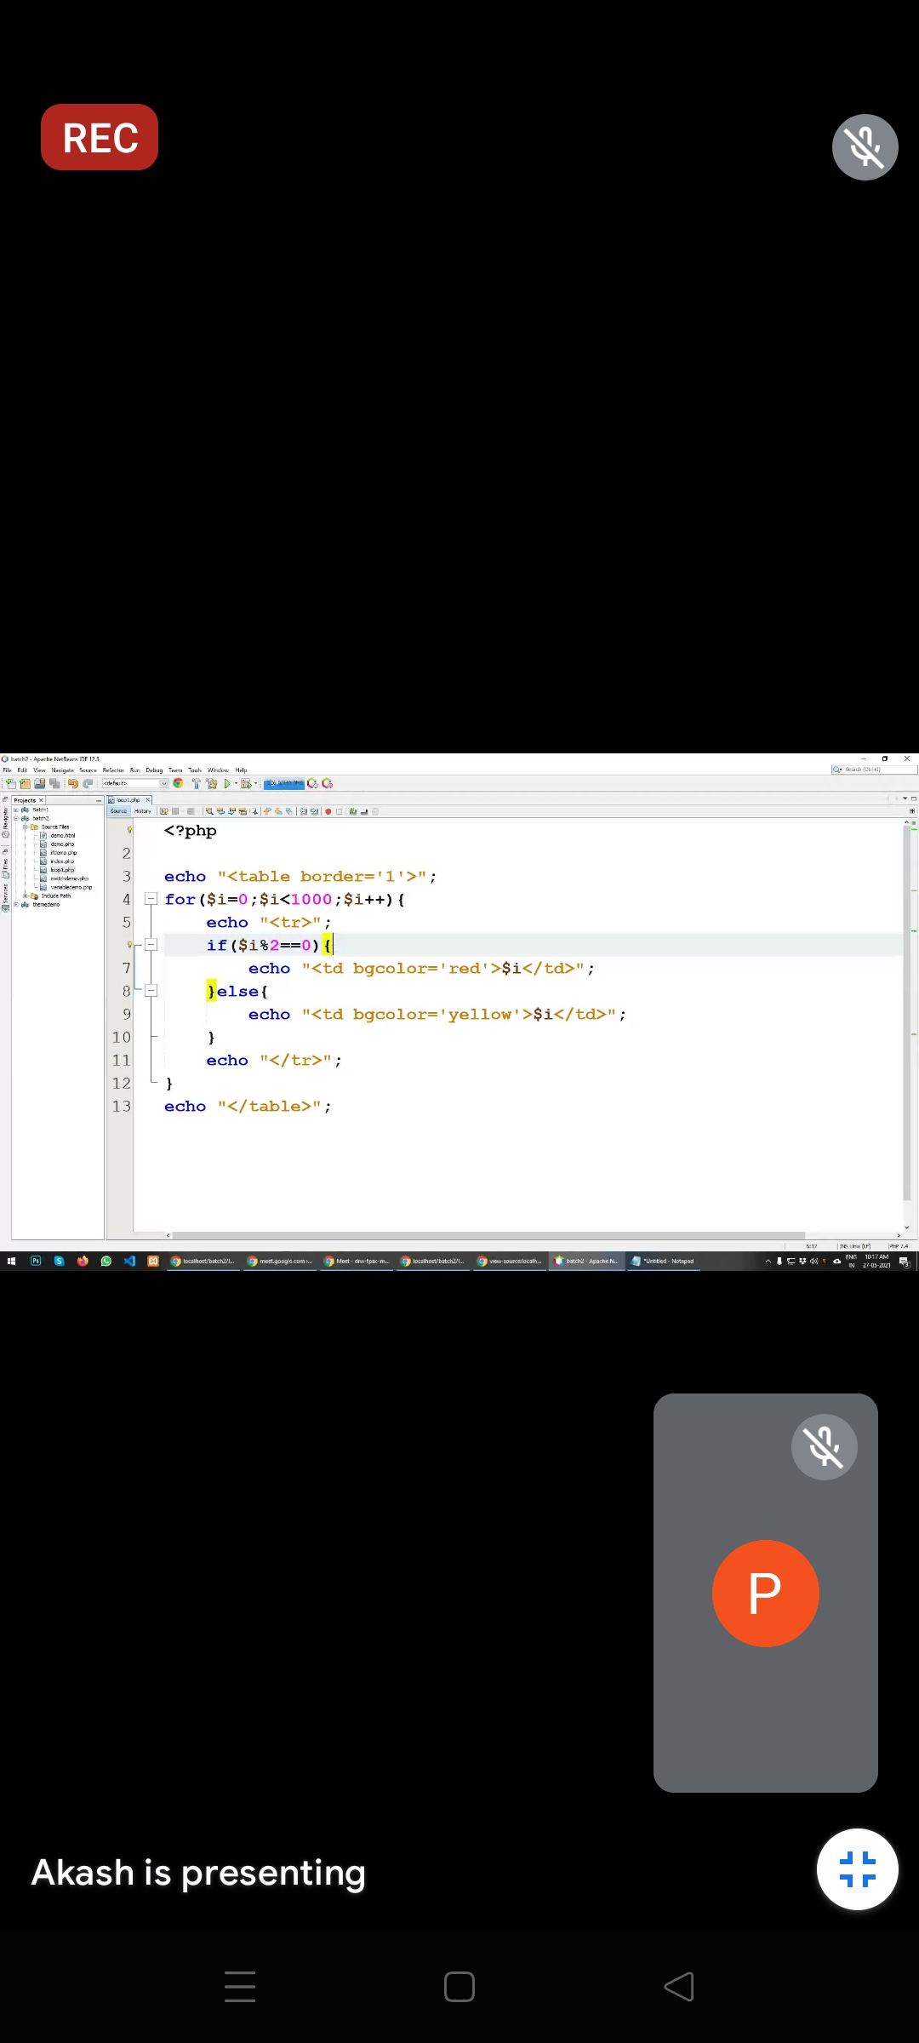
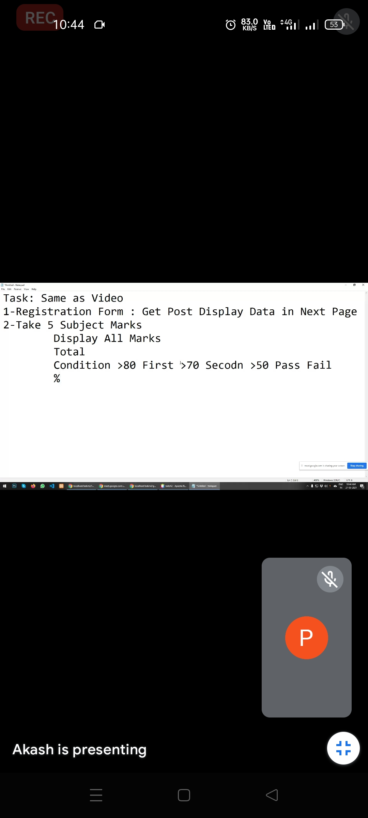
Screenshot of Day-3

Slide 10
Day-4
How to make daynamic websit.
Few Pages must include in PHP…like Home page, About us page, Contact page, Gallary page….
How to calculate charge of website.
How to integrate a theme in your website.

Slide 11
Day-5
Array in PHP.
Types of Array.
Which loop is used to print Loop.
Function of array.

Slide 12
Day-6
Database connectivity in PHP.
How to create database.
How to insert data in database.
Perform insert operation.

Slide 13
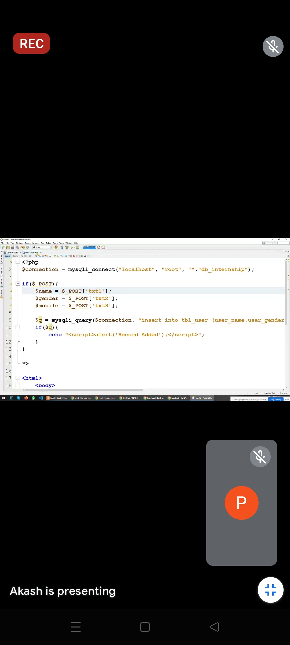
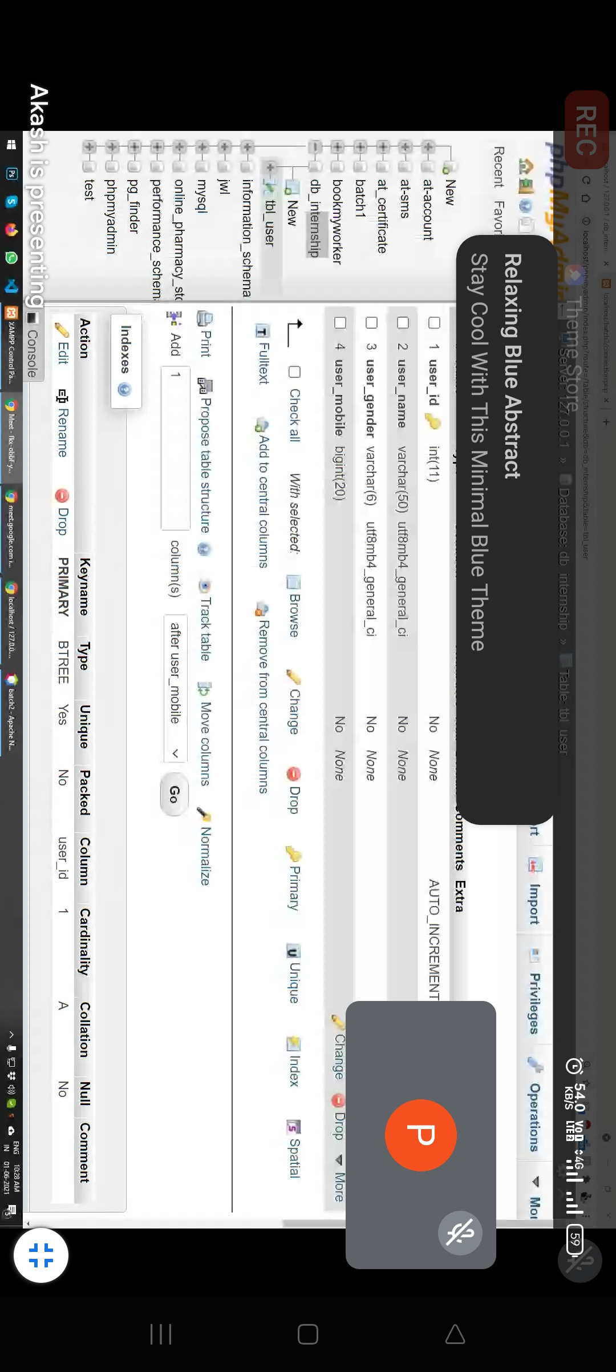
Screenshot of Day-6

Slide 14
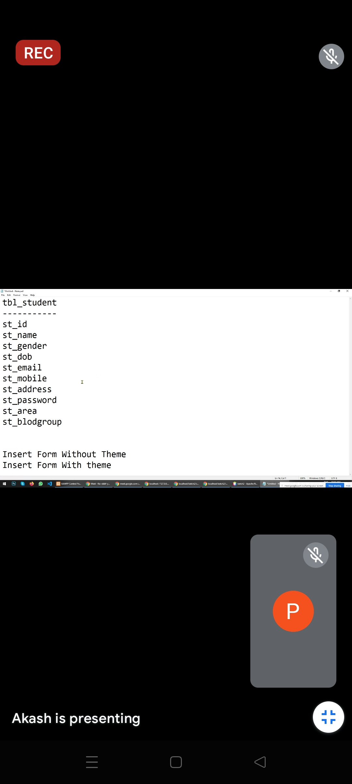
Task of Day-6
Create student table which include following Fields.
Create Student Registration Form with theme and also create Student Registration form without theme
Perform insert Operation in both Form

Slide 15
Day-7
Perform CRUD operation in database.
How to perform soft delete operation. Also learn how big website store their data and how they perform delete operation.

Slide 16
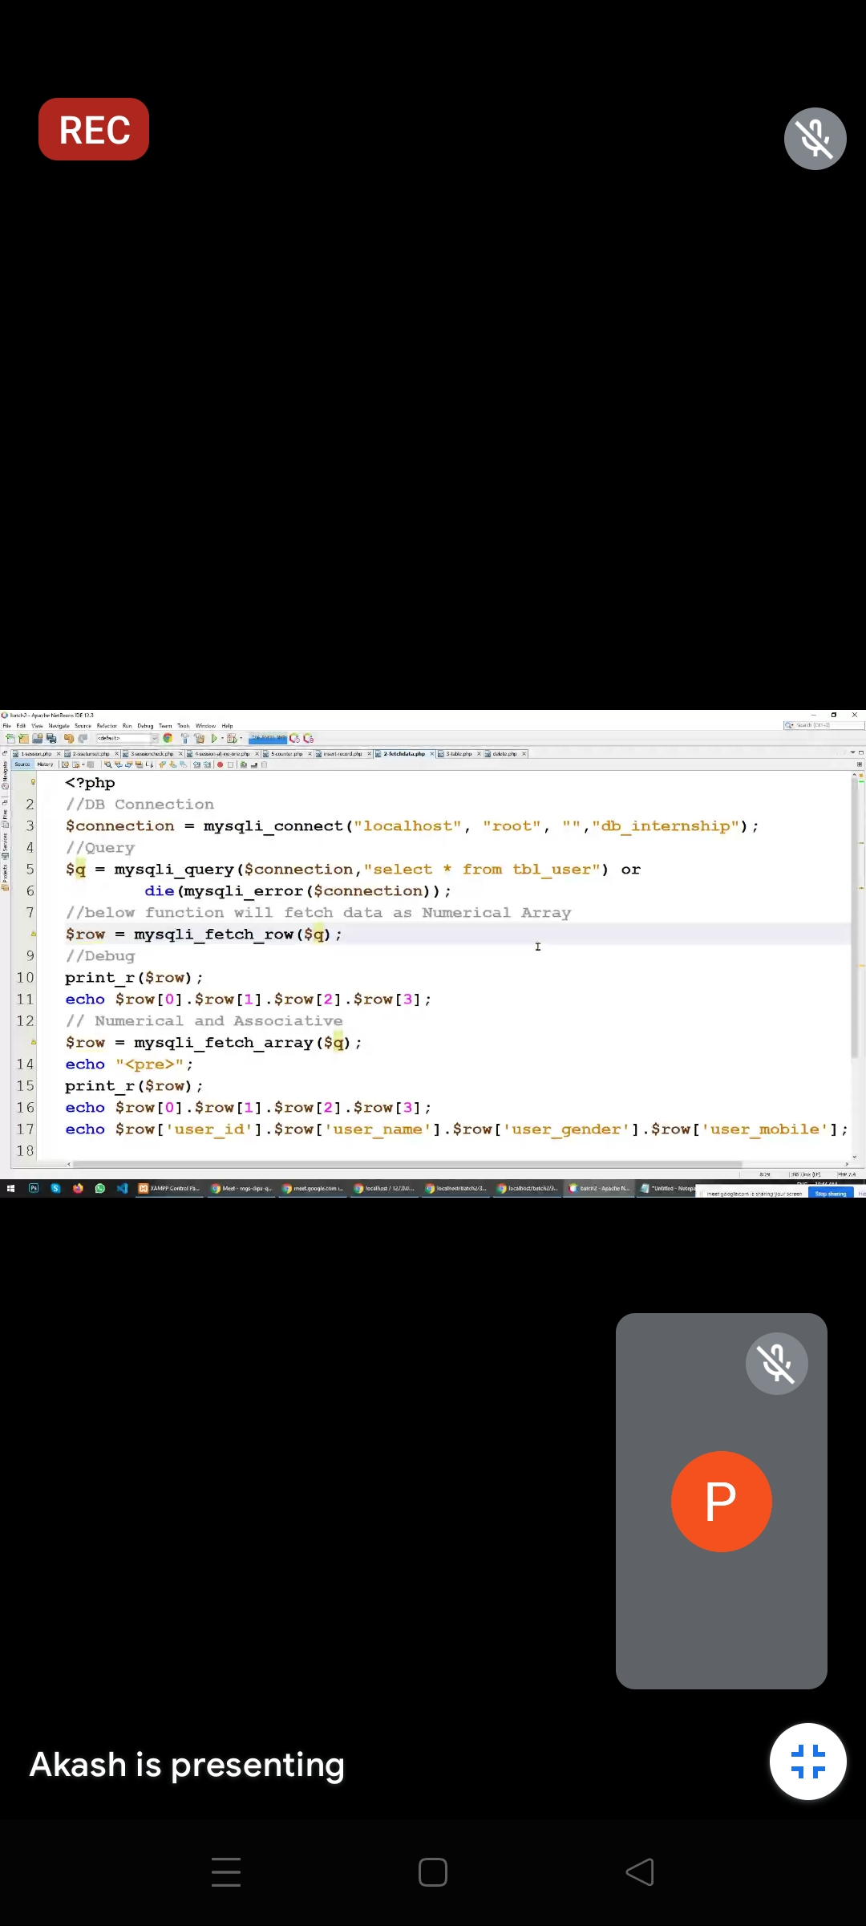
Screenshot of Day-7
Task Perform on Day-7
1) Fetch Data using Mysql Query and print it on FetchData.php page

Slide 17
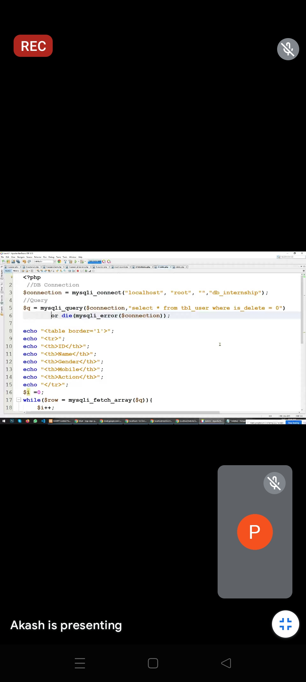
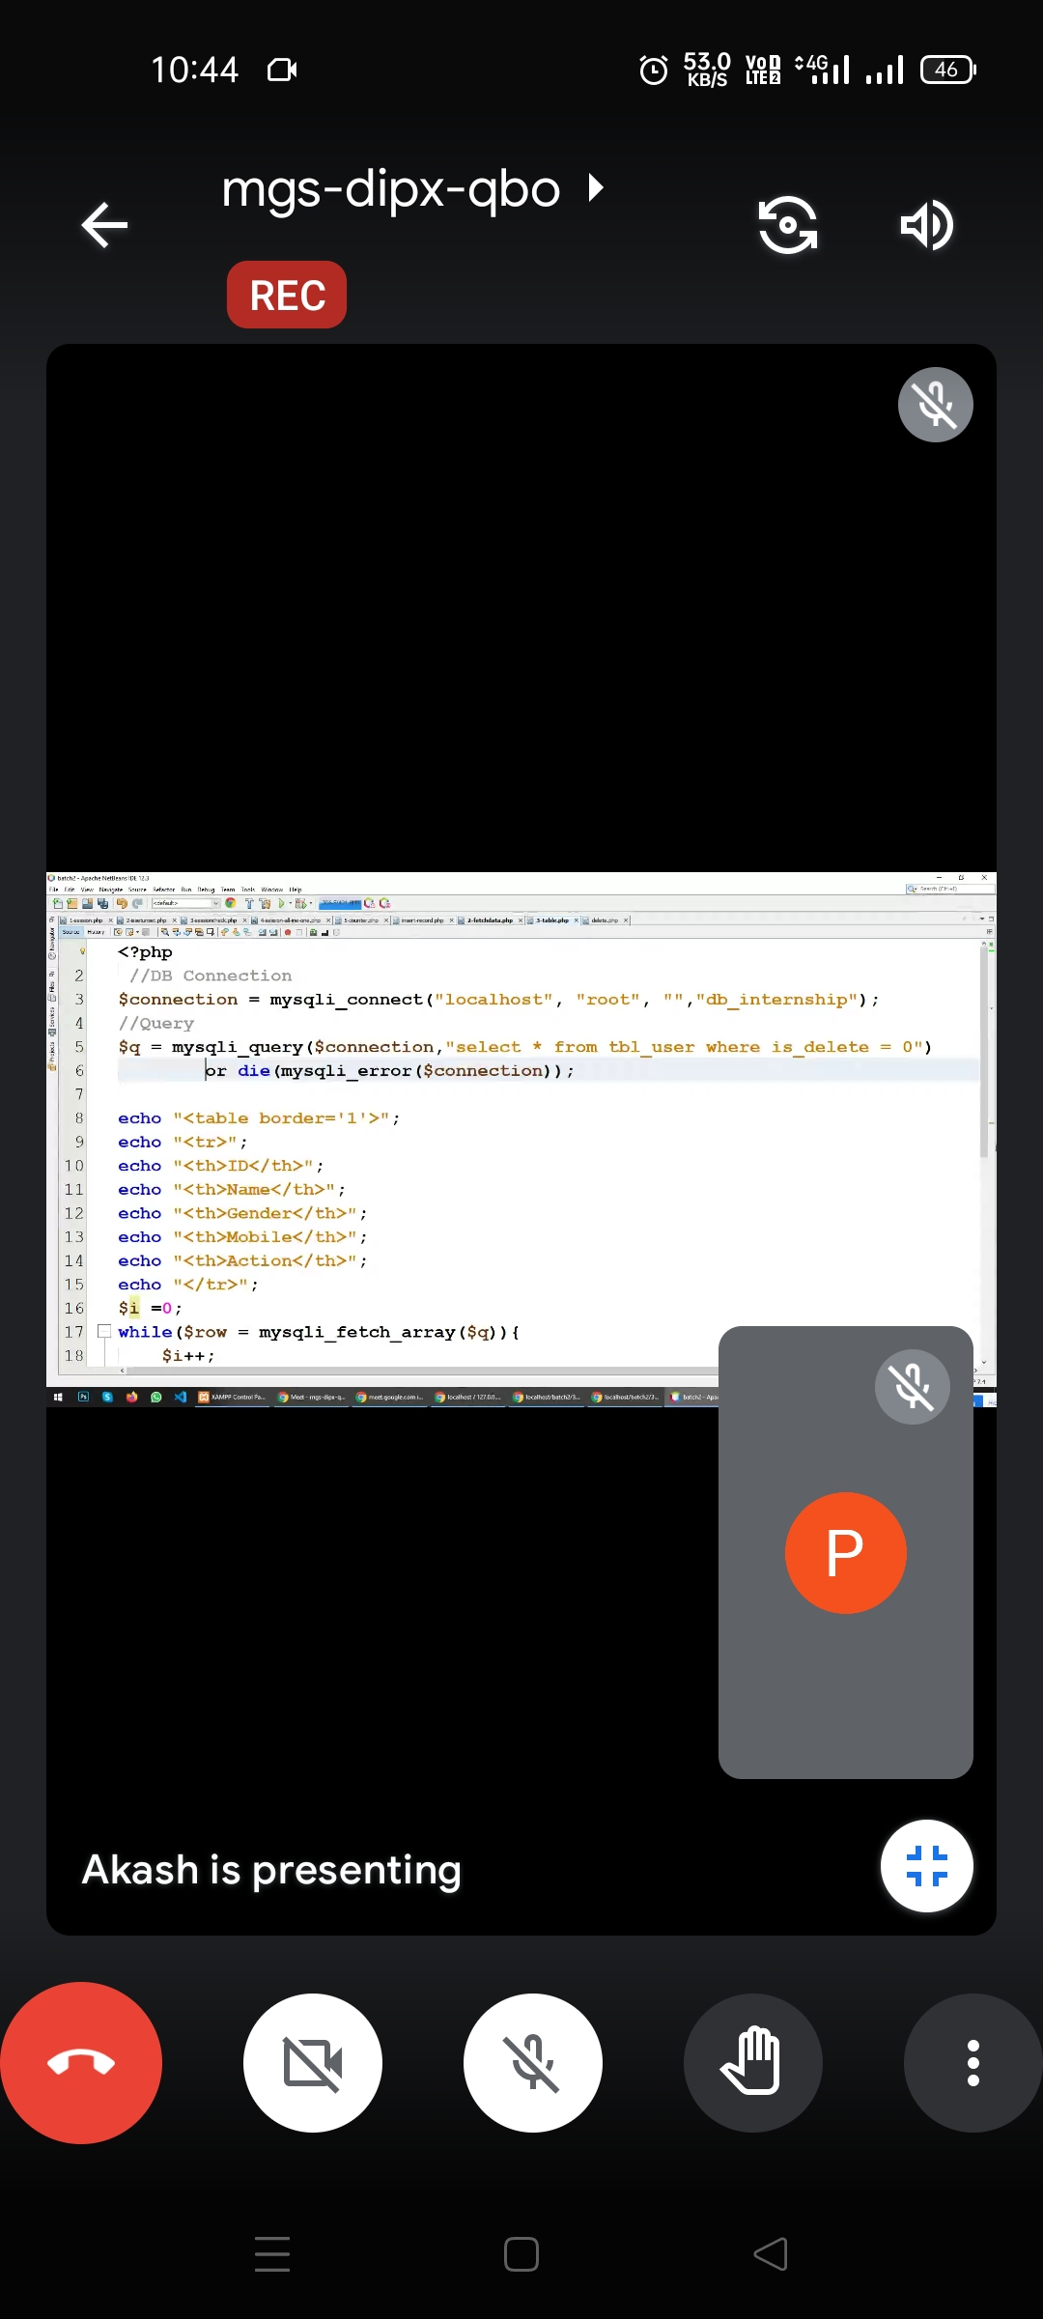
Screenshot of Day-7
Task Perform on Day-7
2) Print Data using Mysql Query and print it on Display.php page

Slide 18
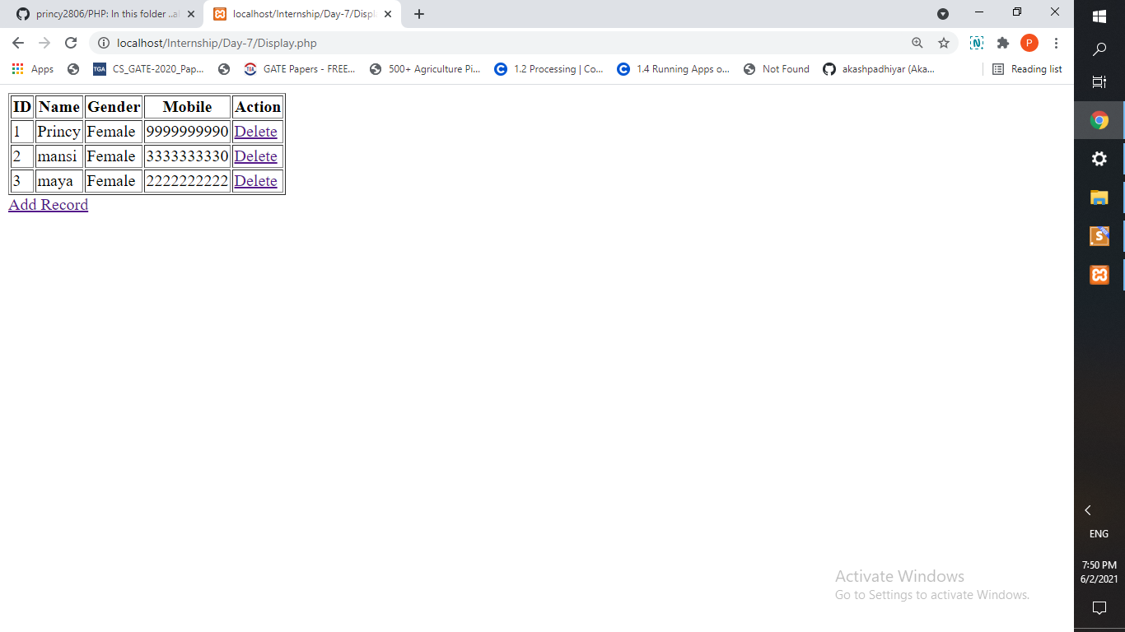
Screenshot of Day-7
2) Input:- Print Data using Mysql Query and print it on Display.php page
Output

Slide 19
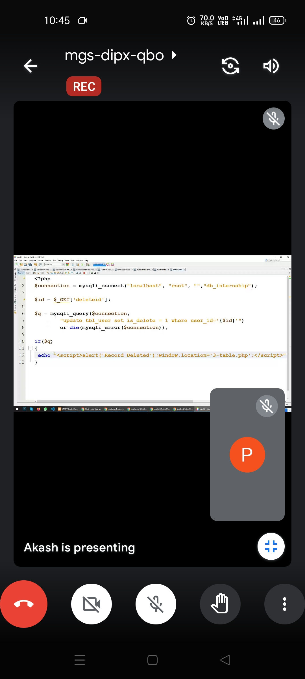

Screenshot of Day-7
Task Perform on Day-7
3) Update Data and also delete data using Mysql Query

Slide 20
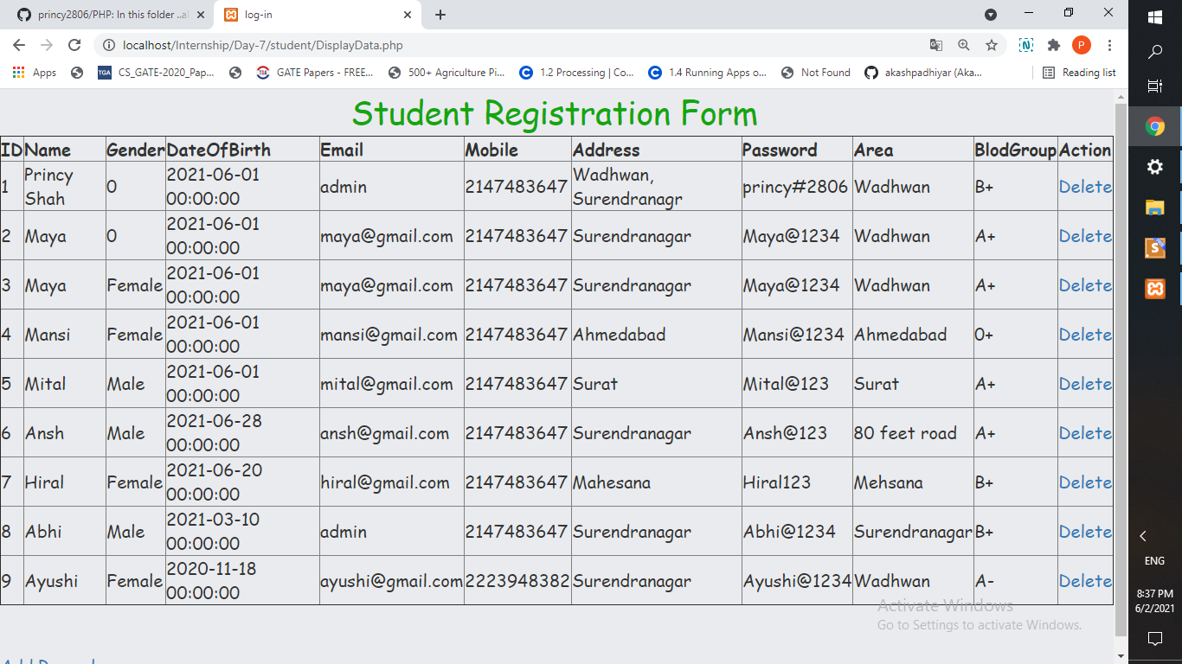
Task of Day-7

Slide 21
Day-8
Perform Update operation in database.
Task: Using any Theme Integrate to design an Admin panel. ..which contain signin, Login, Logout, and forgot password type function

Slide 22
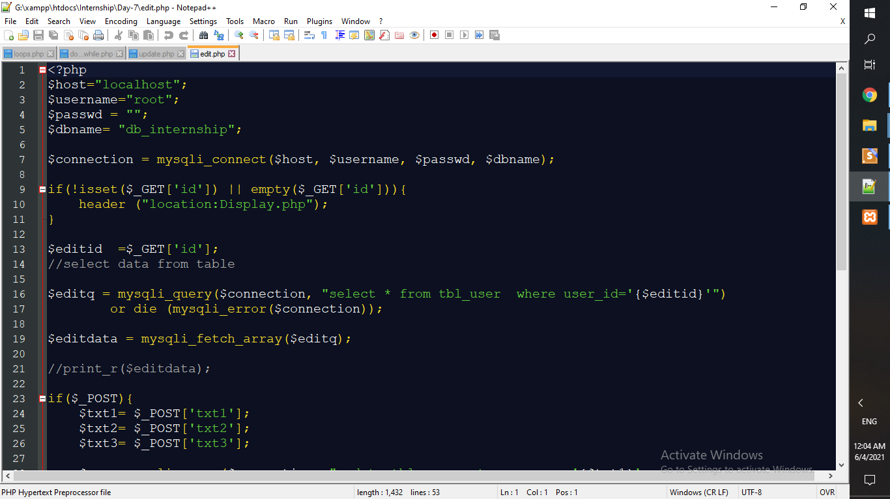
Code of Day-8

Slide 23
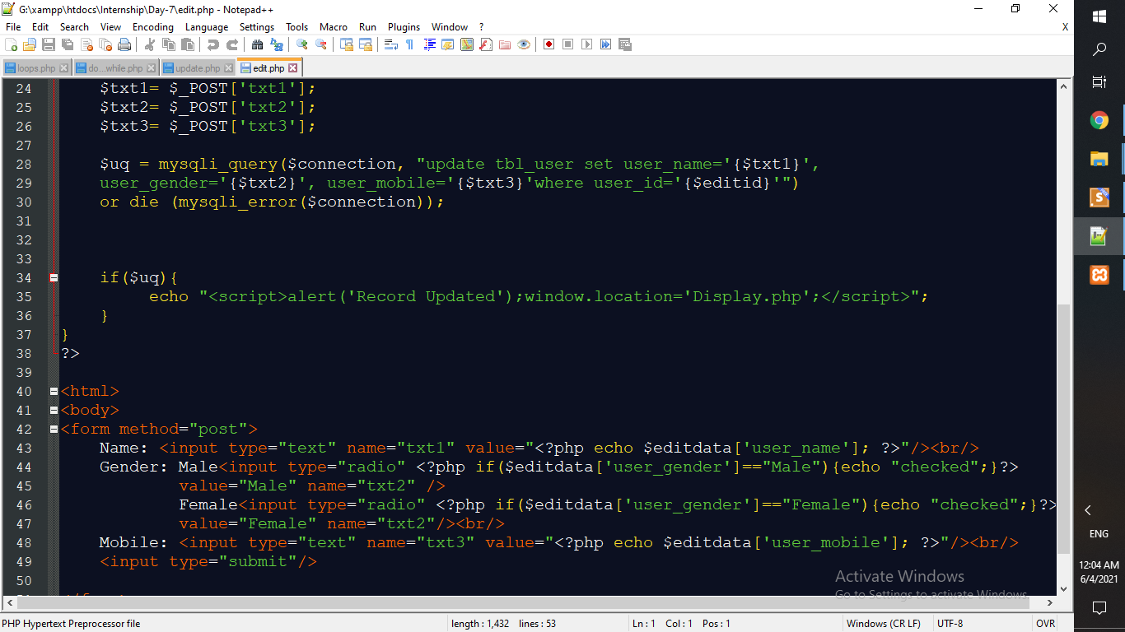
Code of Day-8

Slide 24
Day-9 & 10
Introduaction about wordpress.
How wordpress is used for creating website or Blog.
Task: Create your own small website or Blog Using Wordpress
Introduction about Plugin In Wordpress

Slide 25
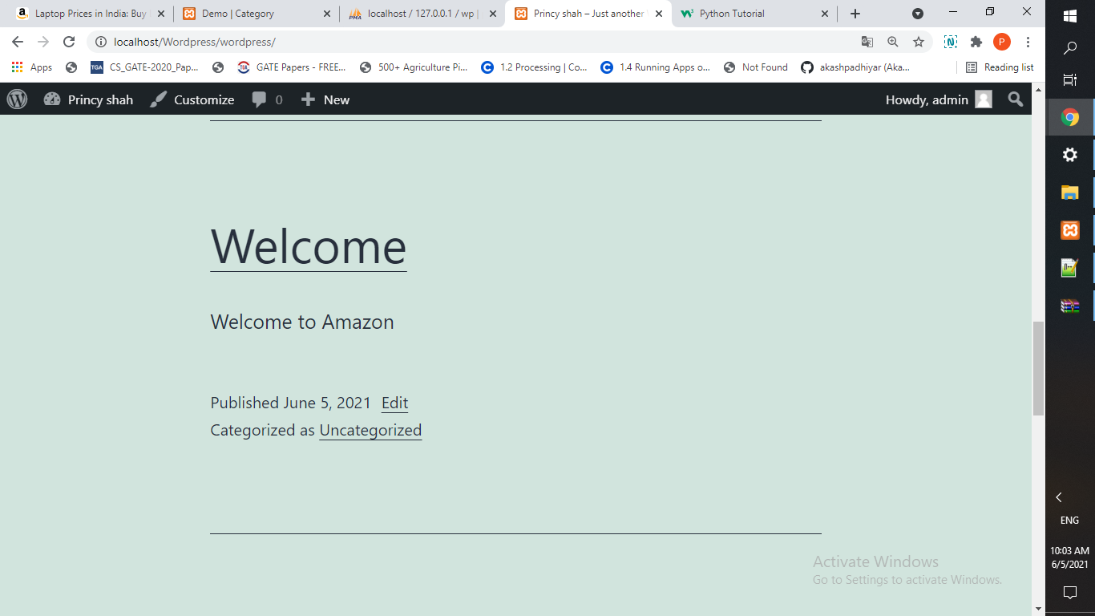
Screenshot of Day- 9 & 10

Slide 26
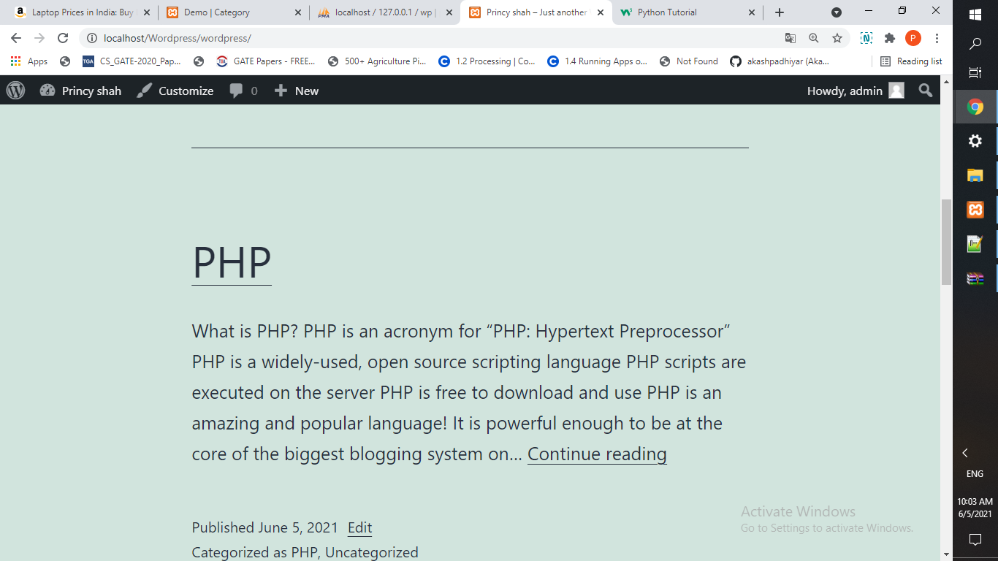
Screenshot of Day- 9 & 10

Slide 27
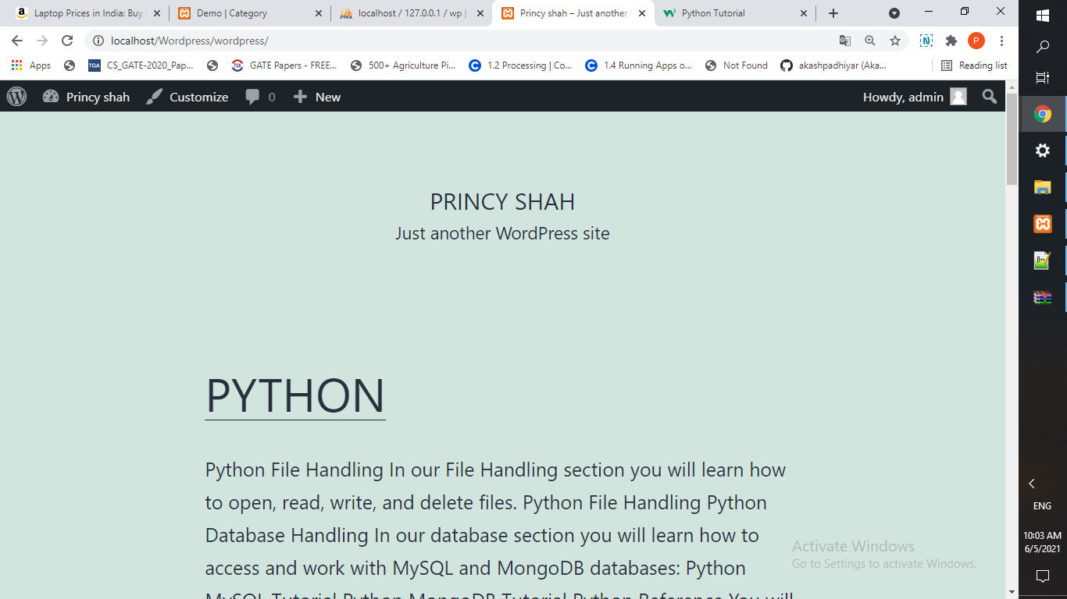
Screenshot of Day- 9 & 10

